Slide 1
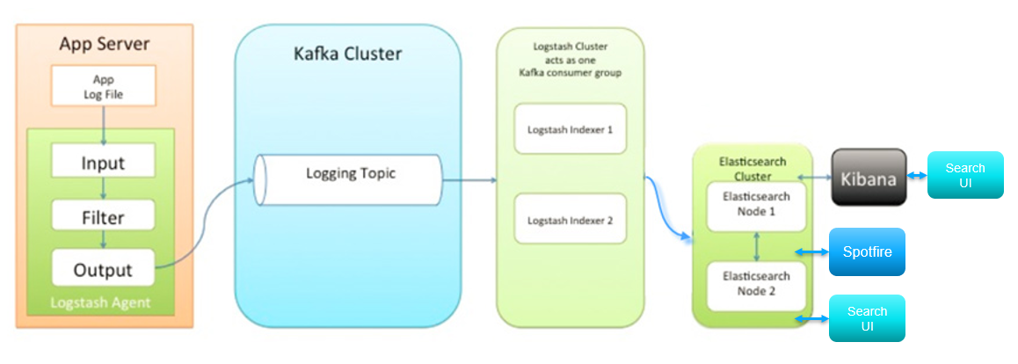
Elastic search ——overall structure
1）成本可控：基于结构化需求，搜索引擎需求替代方案无论在研发或者改造的费用远小于原本购买attivio的产品
2）灵活性更强：项目采用热门技术（ElasticSearch,Logstash,Kafka），资料丰富，无论改造或者定制化功能都会变得相对简单容易，更能满足用户需求
3）原来attivio searchui 在项目中用到的功能，ES SearchUI都能实现，效果还会更好，更稳定
4）最新架构，丢数据不存在的

Slide 2
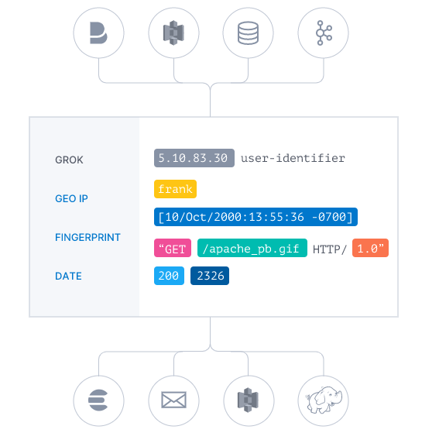
Elastic search ——Parse data module
1）source 包含众多（ES,DB,File…）
2）支持中文编码
3）支持情感分词
4）目标很多（ES,DB,FILE…）
5）结构化规则灵活，除了原始提供内容，支持自定义ruby，java开发结构化组件，集成python
6）支持增量实时获取数据

Slide 3
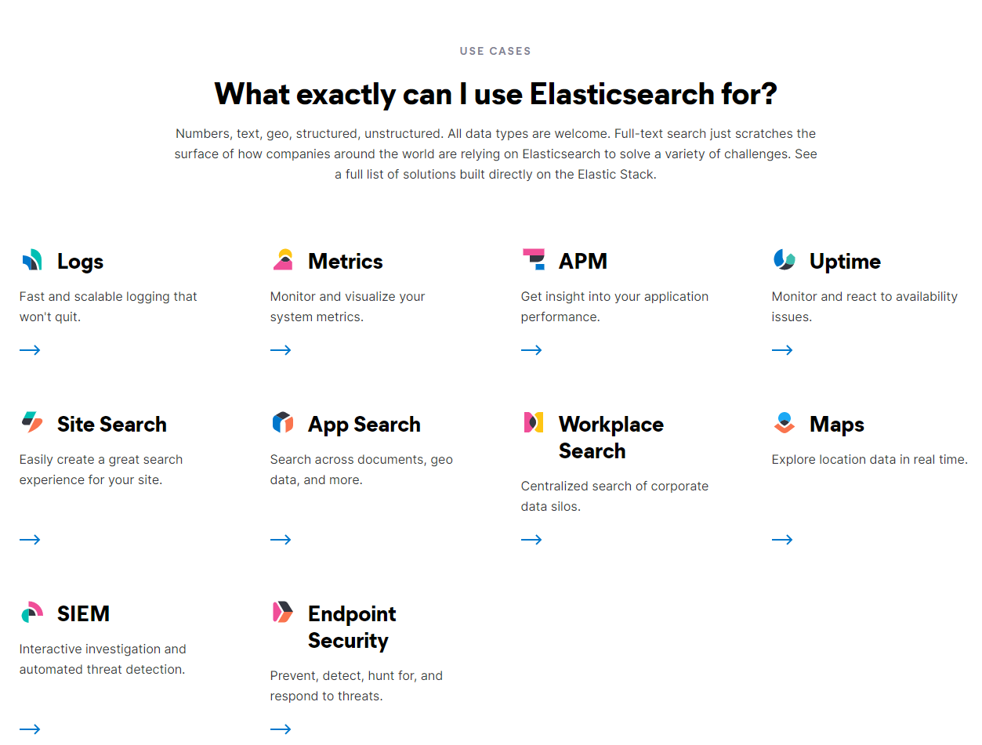
Elastic search ——Search module
1）支持中文语义包
2）支持分布式部署
3）Elasticsearch api丰富
可查看集群状态
可配置快照生命周期
4）完善的安全机制
5）社区活跃，很多高级功能按需应用到项目
（安全机制，报警机制，APM，指标）
6）可塑性强，可与spotfire等第三方客户端交互
同时代码可控可调整

Slide 4
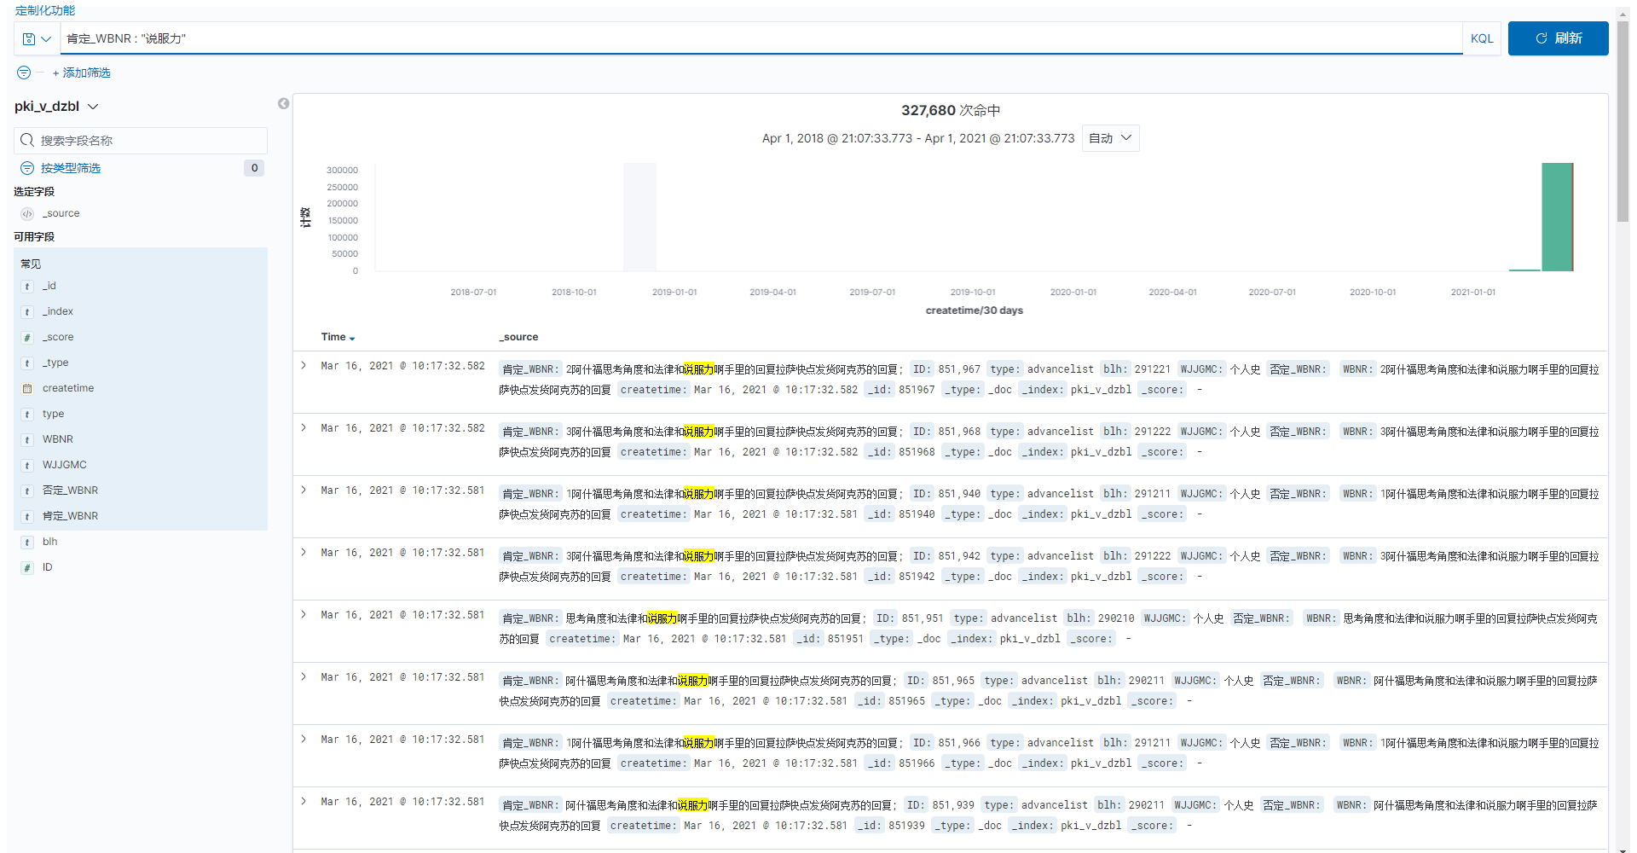
Elastic search ——Search module
5）功能清单：
时间命中
简单搜索
支持聚合查询
复杂搜索
可选索引
可选字段
查询条件可保存
概要展示结果
详细展示结果
定制化功能模块
。
。

Slide 5

Elastic search trial
Features
Complete 100 million data parse
Trial Environment:
Support large data volume parse
✓
Shanghai Sixth People’s Hospital
(Server memory: 128G, CPU: 16 core)
High parsing efficiency
The parse speed is 1.7 million data per hour.
✓
Text Storage Format:
Parse process is stable
100 million data is completed within 72 hours, and the parse speed is stable.
✓
Inpatient EMR and Outpatient EMR stored in Sql Server database in a semi-structured manner
Low resource consumption
During the parse period, the server’s CPU and memory occupancy rate is about 10%
✓
Data Volume:
Search engine retrieval efficiency is high
Search in 100 million indexes, return search results in an average of 3 seconds
✓
100 million records
High accuracy of Chinese semantic retrieval
In the current test cases, the correct rate of Chinese search results returned is 100%
✓
Stable operation
ES has been trial-run for 1 month without any service stoppage
✓

Slide 6
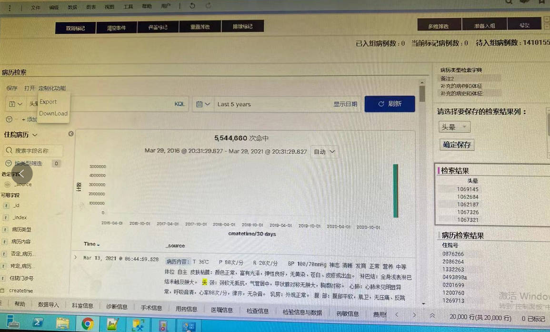
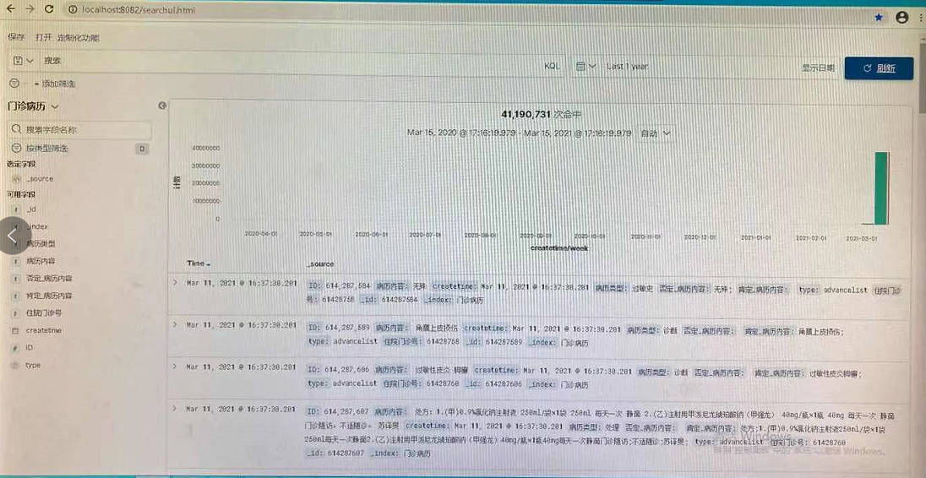
Elastic search trial
Support large data volume parse
Complete 100 million data parse
Inpatient EMR
Outpatient EMR

Slide 7
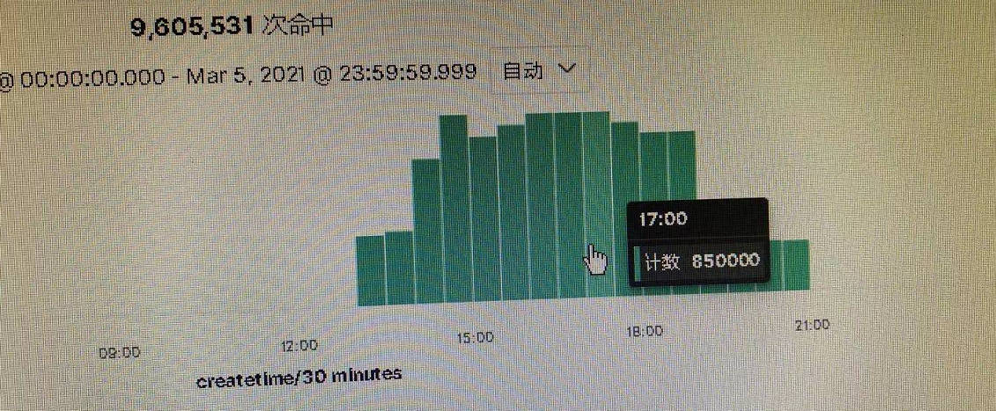
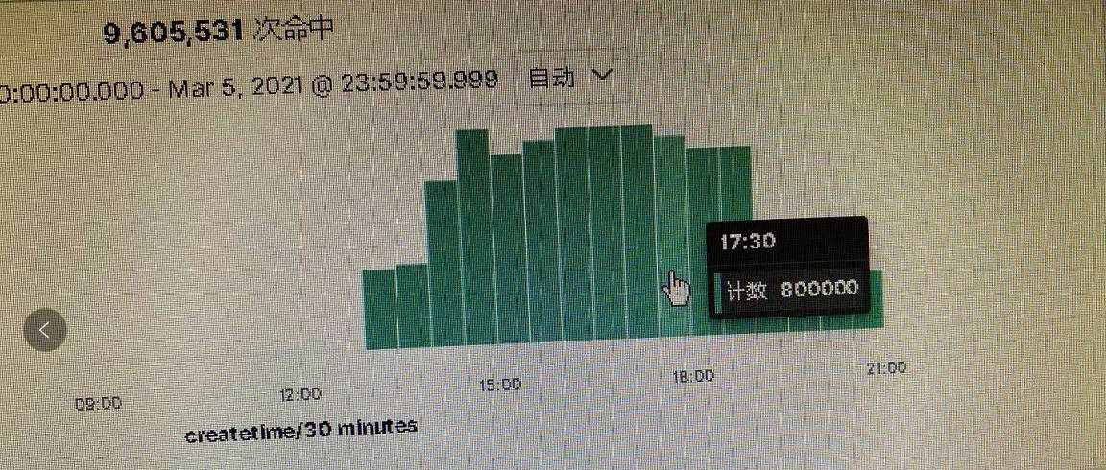
Elastic search trial
High parsing efficiency and parse process is stable
The parse is 1.7 million data per hour and the parse speed is stable.
Half an hour of data
Half an hour of data

Slide 8
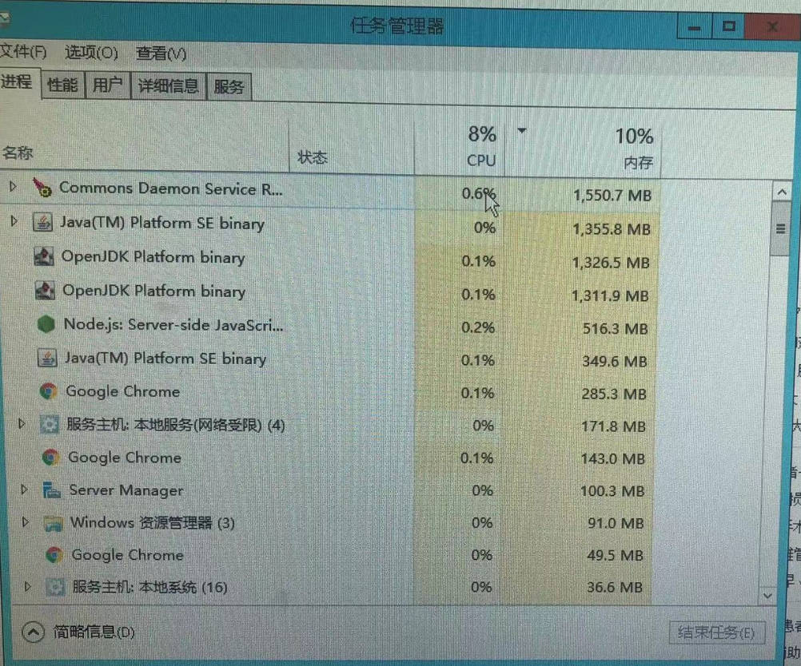
Elastic search trial
Low resource consumption
During the parse period, the server’s CPU and memory occupancy rate is about 10%.
Before running
During running

